Slide 1
IBM University Engagement Project Submission
“Exploring the Power of Agentic AI with IBM Granite and LangFlow”

Slide 2

Project Tile – StartupForge AI: Agentic Startup Blueprint Generator
Domain of Project – Entrepreneurship / Business Intelligence / Startup Ecosystem
Student Name | Recent Passport Photo | Email ID | Mobile number [WhatsApp]
JAISURYA S M |  | jaisuryasm326@gmail.com | 9080004814

Slide 3
Problem Statement :
Problem Statement :Startup Blueprint Generator Agent
The Challenge
Aspiring entrepreneurs often have innovative startup ideas but struggle to transform them into structured business plans. Information related to market research, funding opportunities, government schemes, business models, and startup roadmaps is scattered across multiple sources. Many founders lack access to expert guidance during the early stages of startup development, leading to poor planning, inefficient resource utilization, and high failure rates..
The Objective
Build an AI-powered Startup Blueprint Generator Agent that transforms startup ideas into actionable business blueprints.
The solution should:
• Idea Analysis – Analyze startup ideas and identify target users, problem statements, and value propositions.
• Market Research – Retrieve and summarize market trends, competitors, opportunities, and risks.
• Business Strategy Generation – Recommend revenue models, pricing strategies, customer segments, and value propositions.
• Funding & Grants Discovery – Retrieve startup funding opportunities, government schemes, grants, and incubator programs using RAG.
• Startup Roadmap Planning – Generate step-by-step implementation plans from idea validation to product launch.
• Startup Readiness Assessment – Evaluate feasibility, scalability, funding potential, and innovation through a startup readiness score.
Multi-Agent System –
Idea Analysis Agent,Analyzes startup ideas and extracts business insights,Market Research Agent,Performs competitor analysis,trend analysis, and opportunity identification,Business Model Agent,Generates revenue strategies, pricing models, andcustomer segmentation,Funding Agent,Retrieves funding schemes, grants, incubators, and investor opportunities using RAG,Roadmap Agent,Creates startup execution and growth plans.
Readiness Assessment AgentEvaluates startup feasibility and generates readiness scores.Blueprint Generator Agent.

Slide 4
Technology Used.:
Tech Stack :
LangFlow
IBM watsonx.ai
IBM Granite Models

Slide 5
Proposed Solution .:
The proposed solution is an AI-powered Startup Blueprint Generator that helps entrepreneurs transform raw ideas into structured startup plans.
The system is built using LangFlow, IBM watsonx.ai, IBM Granite Models, and Retrieval-Augmented Generation (RAG).
The architecture consists of multiple intelligent agents that collaborate to generate startup blueprints.
Idea Analysis Agent identifies business opportunities and target audiences.
Market Research Agent analyzes competitors, trends, opportunities, and risks.
Business Model Agent generates revenue strategies and business recommendations.
Funding Agent uses RAG to retrieve relevant startup grants, government schemes, and incubator opportunities from trusted sources.
Roadmap Agent generates implementation timelines and execution plans.
Readiness Assessment Agent evaluates startup viability and generates a readiness score.
Finally, the Blueprint Generator Agent consolidates outputs from all agents into a comprehensive startup blueprint.
The system uses a vector database to store startup-related documents, government schemes, funding information, incubator details, and business resources. Granite models provide reasoning, summarization, and recommendation capabilities, while LangFlow orchestrates the complete multi-agent workflow.

Slide 6
Langflow component Used .:
Chat InputAccepts startup ideas and user requirements.
IBM watsonx AI AgentProcesses startup ideas using IBM Granite models.
Name of IBM Granite ModelGranite-4-H-Small
Chat OutputDisplays startup blueprint recommendations and reports.
File ComponentStores and retrieves startup documents, funding guides, and business resources.
RAG Retrieval ComponentRetrieves relevant startup and funding information from vector databases.
Prompt ComponentDefines specialized prompts for individual agents.
Agent ComponentCoordinates Idea, Market, Business, Funding, Roadmap, and Readiness agents.

Slide 7
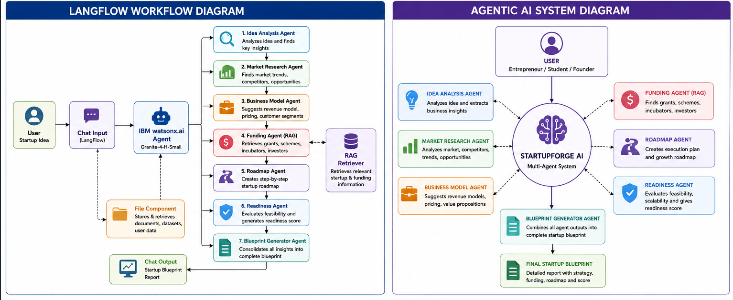
Langflow workflow .:

Slide 8
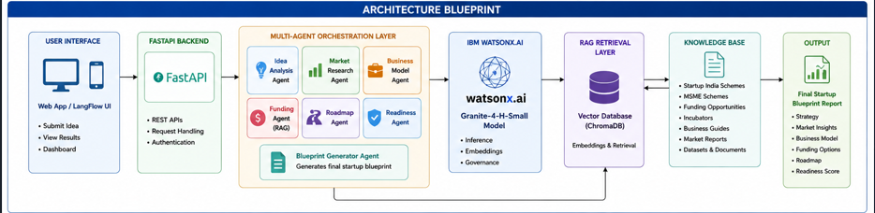
Architecture blueprint .:

Slide 9

Role of Agentic AI in the solution
Agentic AI enables StartupForge AI to function as an autonomous startup consultant rather than a simple chatbot.
Each specialized agent performs a dedicated task such as idea analysis, market research, funding discovery, business strategy generation, and roadmap creation.
The agents collaborate with one another and exchange context, ensuring better decision-making and comprehensive startup planning.
Agentic AI allows the system to dynamically adapt recommendations based on startup domain, funding requirements, target audience, and business goals.
This multi-agent approach improves accuracy, scalability, and personalization while reducing the effort required for startup planning.

Slide 10
Technology Used.:
LangFlow Platform
Visual orchestration of multi-agent workflows.
IBM Granite Model (Granite-4-H-Small)
Startup analysis, reasoning, summarization, and recommendations.
IBM watsonx.ai
Model deployment, AI governance, and inference.
IBM Cloud
Secure deployment and scalable infrastructure.
RAG (Retrieval-Augmented Generation)
Retrieves funding opportunities, startup schemes, and business resources from trusted sources.
Vector Database (ChromaDB)
Stores embeddings for startup-related knowledge retrieval.
FastAPI
Backend API development.

Slide 11
Novelty and Uniqueness
Multi-Agent Startup Consultant – Multiple specialized agents collaborate instead of relying on a single chatbot.
• RAG-Based Startup Intelligence – Uses trusted startup documents and funding resources rather than only model knowledge.
• Startup Readiness Scoring – Evaluates feasibility, scalability, innovation, and funding potential.
• End-to-End Blueprint Generation – Generates complete startup plans from idea to launch.
• Personalized Recommendations – Tailors business strategies according to startup domain and objectives.
• Entrepreneur-Centric Design – Specifically designed for aspiring entrepreneurs and student innovators.

Slide 12
Git Hub Link.: https://github.com/jaisurya36/StartupForageAI.git
·
·
·
·

Slide 13
Future Scope
• Investor Matching Agent
• Pitch Deck Generator Agent
• Financial Forecasting Agent
• Competitor Monitoring Agent
• Legal Compliance Agent
• Startup Registration Assistant
• AI-Based Risk Prediction System
• Integration with Startup India and incubator platforms
The future version can evolve into a complete AI-powered startup ecosystem assistant supporting entrepreneurs from idea generation to business growth.
·
·
·

Slide 14


